Slide 1
ICT Programming Lesson 3:
Working with Control Structures

Slide 2
Objectives
4.3.1: Define ”structured programming,” and discuss the advantages of this approach.
4.3.2: Define the three main programming control structures used in structured programming: sequential, selection (decision), and iteration (loops).
4.3.3: Describe iterative programming structures (e.g., while, do/while, etc.) and how they are used in programming.
4.3.4: Describe selection programming structures (e.g., if/then, else) and explain the logic used for if statements.
4.3.5: Write a simple program in pseudocode that uses structured programming to solve a problem.

Slide 3
Control Structures
Control structures: a block of programming that analyzes variables and choses a direction in which to go
Control structures enable a programmer to determine the order in which instructions are executed, as well as the number of times or even whether an instruction is executed.

Slide 4
Sequence
Instructions that the computer follows one by one from top to bottom
Execute each instruction one after another until it reaches the end of the program

Slide 5
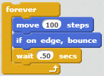
Selection
The “decision” structure.
A “conditional” statement
Allows the computer to make a selection between alternative conditions: If this condition exists, do this; if not, do this.
If the light is green, proceed.
If the light us red, stop.
The computer must evaluate conditions and make a decision about how it should proceed.
Contains: If/Else

Slide 6
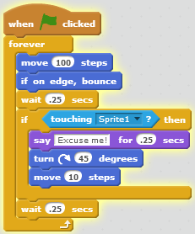
Looping (Iteration)
Includes the while, do while and for statements.
Two basic types of loops are controlled by count or by event.
Often has “Repeat” in structure
A loop structure instructs the computer to repeat a set of instructions, called a loop, until some condition is met.
Logic is pretty simple: While a condition is true, run the loop.

Slide 7
Loop
The conditional test results in a Boolean (true or false) value.
For example: While there is lemonade in the pitcher, keep pouring.
Infinite Loop: a loop that continues repeating without a terminating (ending) condition

